Slide 1
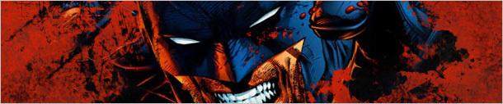
BATMAN: The Dark Knight Returns (1986)

Slide 2
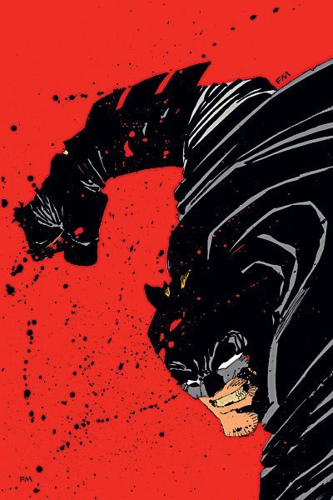

Slide 3
Discussion Questions
What is Miller’s vision in this book?
What is he struggling with? What is his conflict?
Who is the real person? Does Miller emphasize Batman or Bruce Wayne as the disguise?

Slide 4
TDKR: Socio-Political Context
First published as a miniseries in 1986
Futuristic dystopian novel
Setting is mid-late 80’s
Cold war
Ronald Reagan is president of the United States
Superman is an agent of the U.S. (covert)
Dark Knight in retirement for 10years
Forced to return after the age of 60
Story that emphasizes violence for violence sake

Slide 5
(TDKR) Introduction
Altered the way superhero comics were perceived and represented as a medium
Changed the way Batman’s identity was represented
Symbolic rebirth of Batman
In a world overtaken by superheroes, Frank Miller strived to restore the human context in the Batman myth and present the American Urban city as more realistic
First graphic novel of the comic medium
Draws attention to the myth and mythic past of Batman (1:11)

Slide 6
Miller’s approach
Superheroes have lost their human context. That’s precisely why the comics have gotten so weak, and the stories seem so pointless and irrelevant. […] Now, modern superhero comics have reached the point where there are so many damn superheroes and so damn much superpower flying around that there’s no room left for anything human, and the only way to make the genre seem interesting is to wildly escalate the powers, the numbers, the quantity of planets that can be demolished per panel. Just look at how many characters are being killed these days. It’s as if all that is left to them is the pathological thrill of a snuff film.
(Miller quoted in Thompson 34)

Slide 7
Narrative Structure
Structure: Four Books follow a continuous story line
Question: what unifies the four parts? Why not keep it a series?
Each book features a guest villain (each one culminates to a climactic battle):
Book One: Harvey Dent / Two-Face
Book Two: Mutants
Book Three: The Joker
Book Four: Superman

Slide 8
Narrative Structure: Subplots
Joker/Batman
Bruce Wayne/Superman
The mutant siege of Gotham
Batman/Robin

Slide 9
Setting
The “when” and “where” of the action
Specific setting: the precise time(s) and place(s) in which the action takes place (Gotham in the 80’s)
General setting: it is the sense of times in which the story takes place, and how the characters interact with events & social trends taking place in the world at large. It is the larger social and political forces---the era (coldwar era; Reagan govt)
Setting often represents how a character feels (interiority) or an ethical, moral, or social dilemma

Slide 10
Setting: Gotham City
Represented as a crime-plagued urban wasteland
futuristic, dystopian setting
TDKR opens with Gotham under siege—city going to hell
On the verge of chaos; disorder is foreground
Gotham is experiencing an unbearable “heat wave” that “has sparked many acts of civil violence” (1:11)
“Ninety-seven—with no relief in sight”
“City has given up” (1:12)

Slide 11
Opening Scene: Gotham City
Opening Scene: portrays a cityscape almost on fire
smoke rises from the clutter of buildings
apocalyptic sun rising—foreshadows the nuclear near-miss later
Atmosphere seems “surreal”
Repetition of interplay between light and dark throughout
Notion of the living dead (1:12) Batman: “I’m a zombie. A Flying Dutchman. A dead man, ten years dead” (1:12)
Batman comes to life
City inhabitants taking on zombie-like qualities

Slide 12
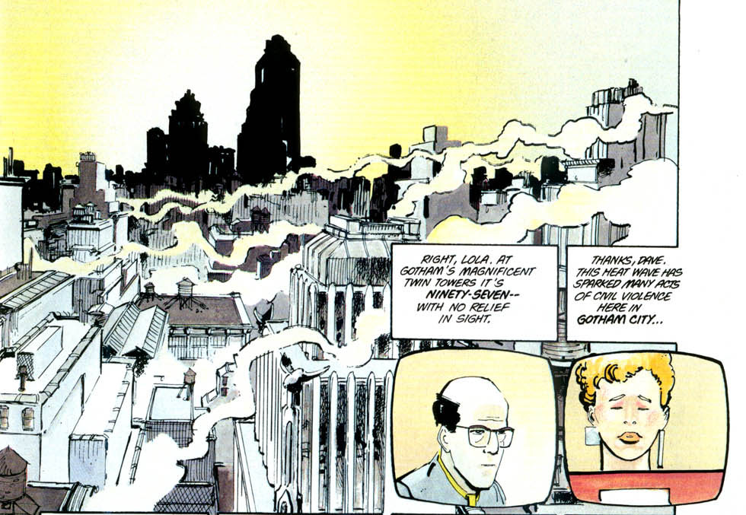
Gotham 1.11

Slide 13
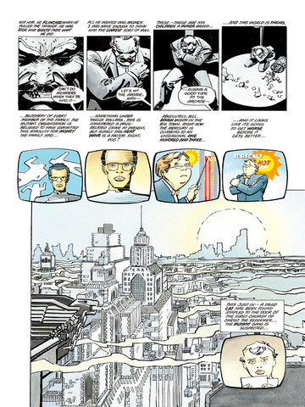
Gotham 1.14

Slide 14
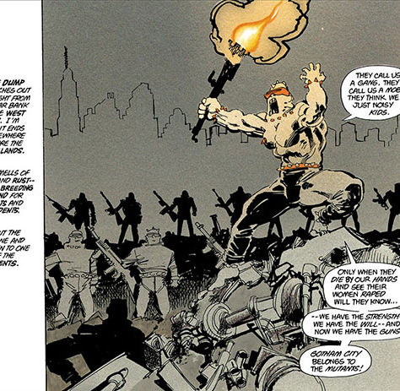
Gotham 1.41
Gotham terrorized by the mutants
Nihilistic cult/gang
Mutant leader is excessively violent
City / American society is a society of excess

Slide 15
Gotham
Miller establishes a very dark vision of Gotham
The darker the vision of Gotham, the more need of recovery of paradise lost
City is out-of-control; values are upside down
Doctor’s are pronouncing deranged villains as cured only to release them, leading to further violence
news media sensationalizing everything
criminals are framed as victims
politicians are complicit– but the disorder is scapegoated
question of responsibility—debated via media throughout the book

Slide 16
Utopia
Utopia: ideal world
Principles of an ideal state:
Perfect politics, laws, customs, conditions,
Based on reason, wisdom, temperance, fortitude, justice
Christian virtues: faith, hope, charity

Slide 17
Dystopia
Dystopia: a utopia that will inevitably go wrong
it is utopia discovered to be the "bad place”
Greek Roots: “Dys” and “topia” meaning “bad” and “place”
An “unfavorable society in which to live” (John Joseph Adams)
Key question: Is the disaster followed by a new world? A fulfillment of salvation? Or, is it an endless repetition of catastrophe?

Slide 18
Dystopia
"In a dystopian story, society itself is typically the antagonist; it is society that is actively working against the protagonist’s aims and desires. This oppression frequently is enacted by a totalitarian or authoritarian government, resulting in the loss of civil liberties and untenable living conditions, caused by any number of circumstances, such as world overpopulation, laws controlling a person’s sexual or reproductive freedom, and living under constant surveillance" (Adams, 2011).

Slide 19
Functions of Setting
Establishes the theme of damnation and redemption
Establishes the impotency and inadequacy of social and political structures and institutions
Sets up the need for a figure above the law to save and redeem the morally vacant community
This is very in keeping with the paradigms of the American
“monomyth”

Slide 20
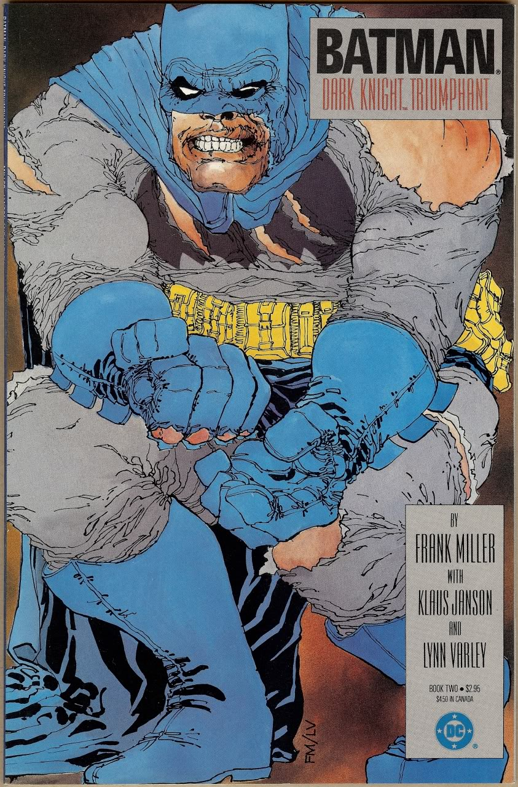
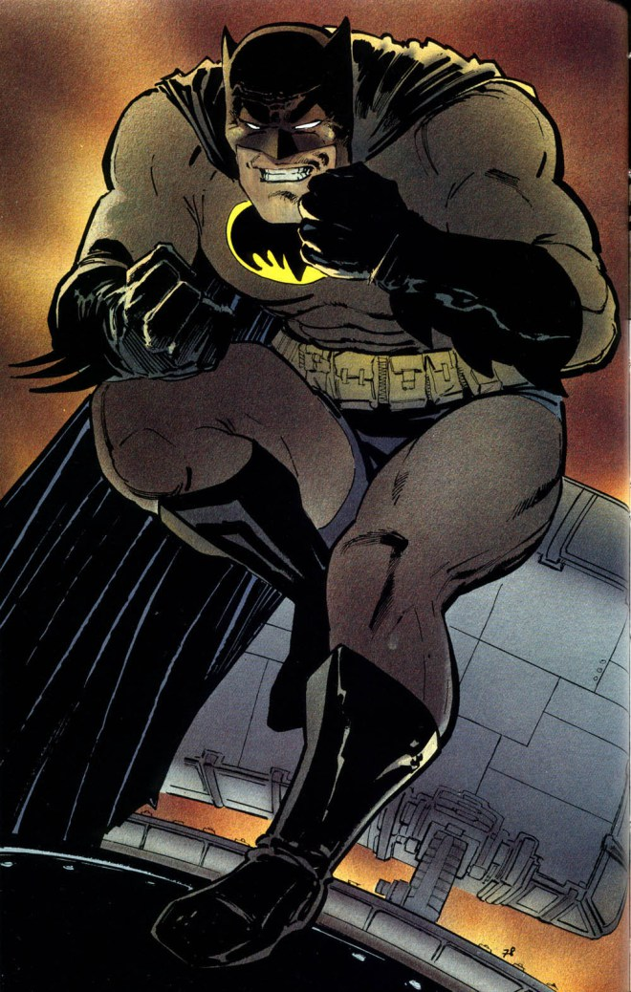
Masculinity

Slide 21
Batman: Rejuvenated Masculinity
Impotency of city leaders and institutions represented by helpless male leaders (mayor, police men)
Anxieties about masculinity , weakness, and loss of patriarchal power in the face of external threat
Mayor’s throat torn out—symbolic castration
Associated with rejuvenated and virile masculinity
Batman is back, manlier than ever—he enforces the law on his own terms—restore social order based on masculine rule

Slide 22
Power and Masculinity
In TDKR, Bruce tries to reject batman in Book 1 but his inner voice compels him to reinstate his masculine power (1:25)
Batman expresses anxieties about his age and physical prowess
Evident in his battle with the leader of mutants
Dark side emerging--See image (1:19)

Slide 23
Batman’s Body
Body in pain; wounded
Aged body
Violence and masculinity
Physical punishment---many references to Batman’s injured and bloody body
Batman returns with an emphasis on his physicality
Physical dominance and presence is undeniable
Phallic images of his body throughout
Images of an exaggerated physique: bulging muscles; square-jaws; massive hands; broad shoulders; smaller head
The frame of the comic book panels or pages cannot contain the massiveness of him
Technique: splash images: poster-like images that take up an entire frame
He dwarfs all other images, explodes out of the frame

Slide 24
Batman’s body cont’d
His ability to endure physical pain is what helps him dominate Gotham city
Book 2: describe the physical fight between the mutant leader and Batman
He reaffirms his masculinity and prevails
“savagery”; a beastiality to the fight; a raw violence
Fight focuses on physical body parts;
Batman infantilizes him by calling him “boy”
Disarms the mutant’s gang which transforms into his vigilante gang, “The Sons of Batman”
Recurrent motif: bloody rebirth
Regeneration and renewal of society through violence

Slide 25
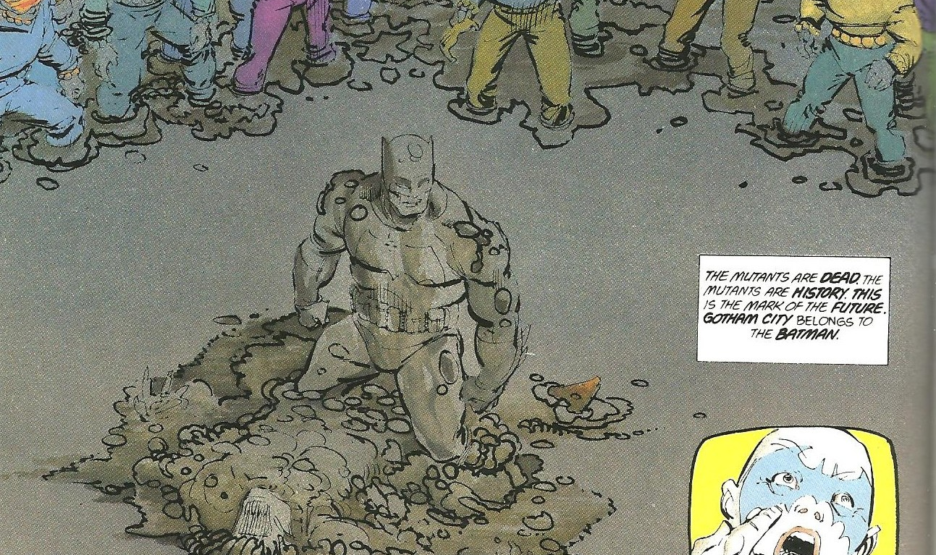
Victory & physical power

Slide 26
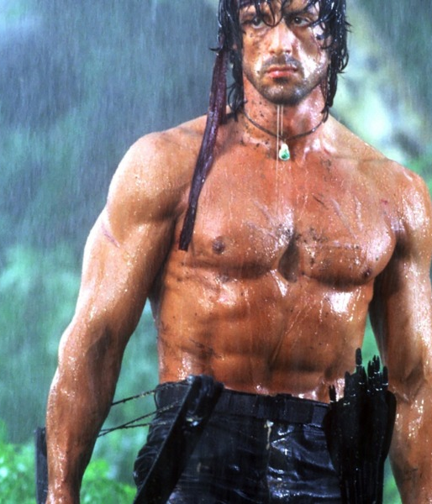
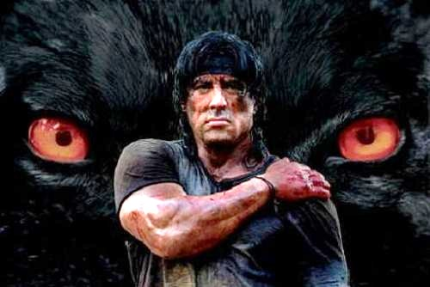
Rambo

Slide 27
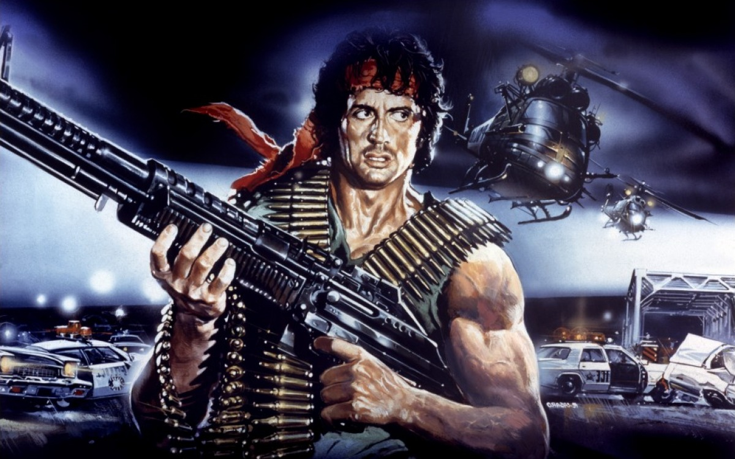

Slide 28
Batman: “Rambo in a cape”?
Batman is unwelcomed by and alienated within his own city
Weapons; heavily armed
Military tanks; military helicopters
Hyper-masculinity linked to military prowess
Book Four: constructed as a cyborg
Masculine language—tough-guy expressions or one-liners
“I’m the worst nightmare you ever had” ; “Do you know who I am punk?” (2:67) Examine this interrogation scene
What is the function of masculinized language?
Reinstitution of masculine language=restoration of patriarchal and paternal authority that underlies the social order (image page 92)
Think about Robin as a younger girl

Slide 29
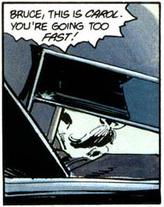
Book 1

Slide 30
Book One: psychological struggle
the struggle between Bruce Wayne and the resurfacing of his alter ego
He cannot contain Batman
A voice in his head
the motif of the shattering glass
By the end of the first book, Bruce is completely subsumed by Batman
Batman is the dominant persona
Also about establishing institutional and social corruption (media, psychiatry, law, politics)

Slide 31
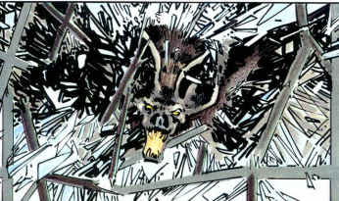
Recurring theme: Confronting our inner darkness

Slide 32
Bruce’s Inner Struggle
Represents a struggle to face the madness and suffering that is a part of his life
Encounters with Bat: symbolic of rebirth
The idea is that the exposure to the bat can lead to becoming a hero if the bat is embraced, or a villain if the bat is rejected.
In other words, if you can embrace both suffering and joy, you can be a hero

Slide 33
Wayne/Batman (Duality)
Wayne/Batman; Batman always referred to as a “shadow”; a Jungian archetype
Bats as symbols of evil and the devil
Wayne accepts his shadow and channels it into good
Batman is compelling because Wayne is able to control his shadow
Do the criminals of Gotham legitimize his dark side?

Slide 34
Vigilantism
Vigilantism: people who work outside the normal channels of law to administer justice; taking the law into your own hands when legal agencies or political (justice) systems have failed them; are inadequate
Superman, Batman, Captain America, Spiderman all fall into this realm
“extralegal violence and personal revenge” (Lawrence and Jewett) are both essential to the story
Is this what sets Batman apart from the rest?

Slide 35
Subplot: Superman vs Batman (Book Four)
Revenge as Justice
Batman’s entire existence is based on a personal quest for justice
Is this representative of a national way to respond? (to avenge?)
Is this the American way?
Commentary on the Reagan era (conservative 1980’s; cold war politics).
Herein lies the crucial element of the story or idea of American vigilantism: to achieve justice, the vigilante must meet violence with OVERWHELMING force, whether through a vigilante community or gigantic muscle power
Might makes right (is the premise)

Slide 36
Book 4 cont’d
In this final story, Gotham faces a nuclear apocalypse
Depictions of President Reagan: either as a voice over or just a talking head
Like Big Brother watching; like a false consciousness that appears and shows itself as a falsity
Reagan is depicted as sinister, and even ridiculous and absurd
Superman is depicted as saying yes “to anyone with a badge—or a flag” (4)
The critique here is not so much on Batman as it is on Superman’s mythic heroism

Slide 37
All eyes on Batman: the scapegoat
Throughout TDKR, Miller gestures towards this critique through the narrative interjections of the media debate about Batman’s return
Batman presented as "psychotic," "morally bankrupt," "fascist,"
his extreme actions are the causes of the very problems he sets out to resolve
He commit crimes "using his so-called villains as narcissistic proxies" (1).
The debate remains unresolved in the text

Slide 38
Apocalyptic elements
The sun returns in book 4
Blurred with explosion of a missile fired by the Russian army
"this … is the end … for both of us" (4).
Complex ending: batman defeats and loses to Superman at the same time
In book 4 he becomes mythological—not knowable anymore
He does in a sense die, but is dug up by Robin (Carrie)
Dark ending
The novel ends with his promise to stay underground, “stay quiet”
We are led to believe of another return; a rebirth in another form—a community of crime fighters
“it begins here—an army to bring sense to a world plagued by worse than thieves and murderers" (4:199).
From Batman (an individual superhero) to the Sons of Batman—a movement

Slide 39
Role of Media / Television
Miller presents some panels as “TV screens,” with their text placed above them. These form a running commentary on the action, as well as presenting exposition.
They also enable transitions between scenes.
Media reports on Batman’s vigilantism—core topic of debate
Television images can be quite intrusive in terms of the paneling representing the intrusion into Bruce Wayne’s life (1:23-24)
Represents multiple perspectives
The distortions of the media—truth or fiction?
Myth and reality are blurred; question of representation

Slide 40
Themes
Relationship between Bruce Wayne and Clark Kent
The excess of American society
Scathing critique of media (mis)representation (distortion)
Indictment of the law, social order, and other forms of government authority and ethics
Co-dependence constitutes Batman-Joker relationship
Duality of self
Role of women
The limits of vigilantism
The blindness behind civil obedience
Batman’s struggle with being “caged in” (see grid structure)

Slide 41
Symbolism & Imagery
The bat
The United States Flag
Shattered/ broken glass or mirrors
Bars/cages
The sun
Light/dark

Slide 42
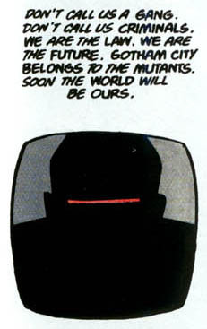
Book 2: The Mutants/Sons of Batman
A playful take on
X-men?

Slide 43
Book 2: Batman & Robin Plotline
“Sons” of Batman
Carrie Kelly—Robin; symbolic daughter of Batman
Irony: she rescues Batman from death (p.85)
Female: nonviolent figure, healer role
She plays pranks; uses children’s toys (slingshot on
p. 108)
She is an adolescent (13 yrs old)
Batman in a paternal role
Resemblance between Robin and commissioner Yindel

Slide 44
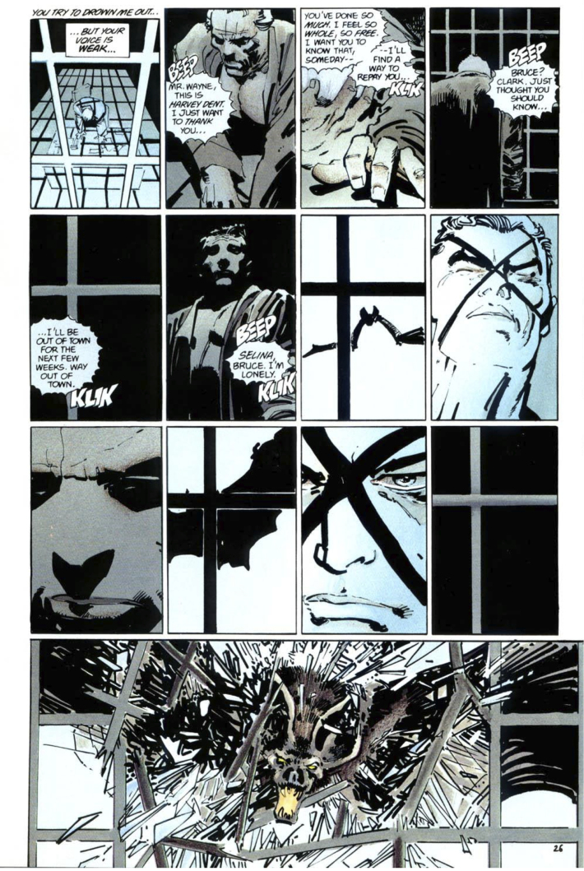
Cross references between Books 1&2
Recurrent appearances of the bat
Crashing through windows
Triggering Bruce into relapses into Batman

Slide 45
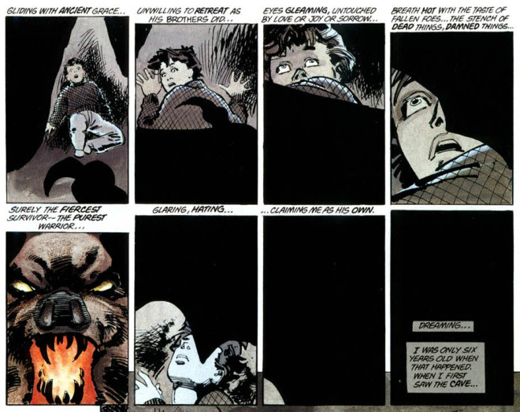
Book 1, p. 19

Slide 46
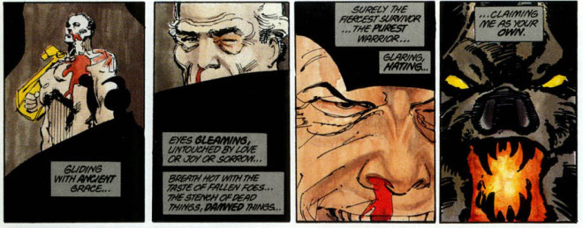
Book 2, p. 88

Slide 47
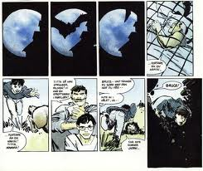
Book 1, p. 17

Slide 48
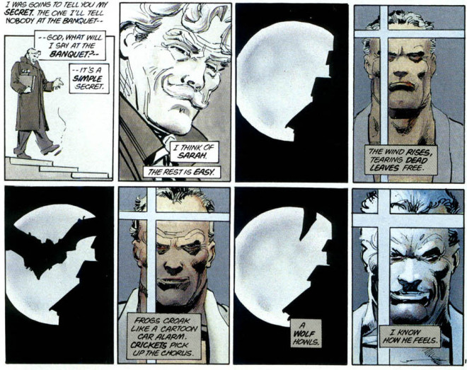
Book 2

Slide 49
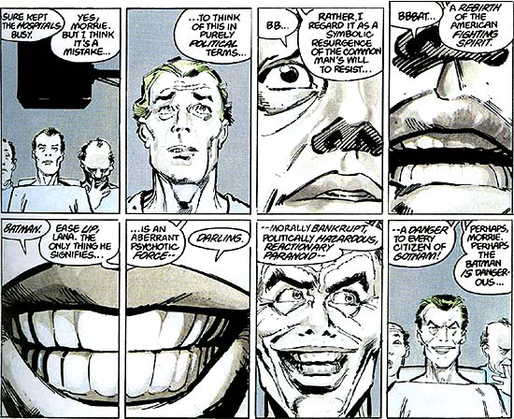
Book 3: “Hunt the Dark Knight” / Plotline: Joker and Batman

Slide 50
Superhero Code: Narrative
In terms of narrative: villains are proactive; superheroes are reactive. The villain drives the plot, superhero reacts to villain’s threats which justifies the violence
See Dr. Bartholmew Wolper’s discussion of the above dynamic in TDRK Book 1, p. 47—implications: criminals are not responsible for their crimes; therefore vigilantism is ineffective
See previous panels of Joker’s awakening into consciousness—villain reacts to Batman

Slide 51
Superhero Code: Genre
In terms of genre: villains are reactive; superheroes are proactive. Villains are created in reaction to the superhero’s ability to defeat regular criminals. The idea is that regular criminality escalates to supervillainy
Based on the code—justifies the hero’s own interpretation of justice
“with great power comes great responsibility”
Exception to the code: no killing
Killing: does it transform the hero into proactive?
Example: Ozymandias (does he move from superhero to villain?)

Slide 52
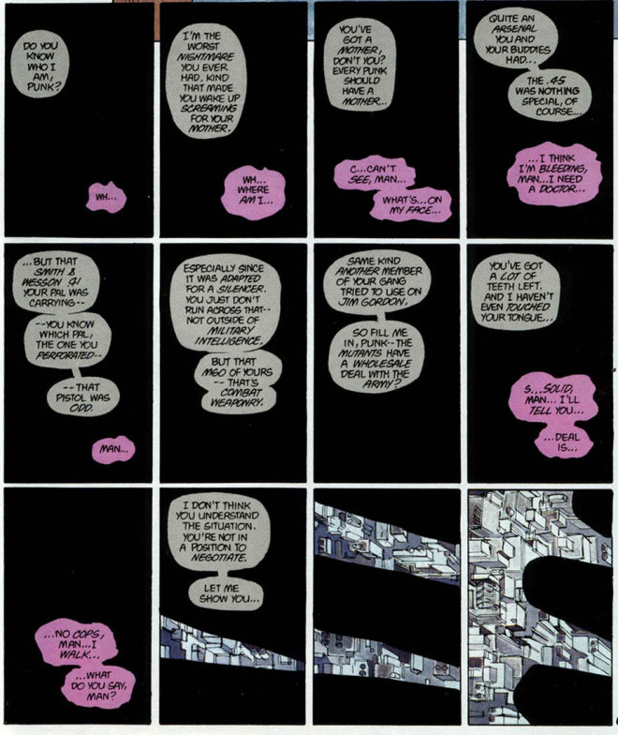
TDKR, p.67

Slide 53
Bat Cave
Underground laboratory of Bruce Wayne
Grave-like
Where transformation and identity change happens
Labyrinthine space
Psychoanalysis: symbolic of “womb”—a space for security, protection and nurturing—return to the mother. Batman as child

Slide 54
Resources & Web Links
http://www.cracked.com/article_20111_the-6-most-brutal-murders-committed-by-batman.html
TDKR Part 1:
http://www.animeflavor.com/node/42838
TDRK Part 2:
http://www.animeflavor.com/cartoon/batman-dark-knight-returns-part-2

